Slide 1
Traffic Analysis System

Slide 2
Traffic Analysis System
Object Detection System (YOLOv4)
Object Tracking System (Norfair)
Data Analysis Modules
Vehicle types
Traffic lanes
Speed
Density, etc.

Slide 3



Traffic Analysis System
Object Detection
(YOLOv4)
Object Tracking
(Norfair)
CCTV Video
Database
Reports
Data Analysis
Modules
Data Analysis
Modules

Slide 4
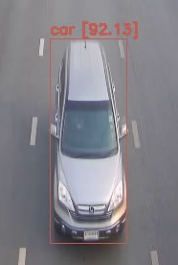
Object Detection System (YOLOv4)
Table: detect_CCTV_YYMMDD
Object Detection
(YOLOv4)
Column | Data
* Frame no. | 297
* Object no. | 1
Type | car
Confidence | 51.23
X1 | 226
Y1 | 482
X2 | 123
Y2 | 247
CCTV Video
Database

Slide 5
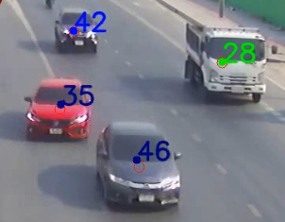
Object Tracking System (Norfair)
Table:
detect_CCTV_YYMMDD
Table: track_CCTV_YYMMDD
Object Tracking
(Norfair)
Table:
track_CCTV_YYMMDD
Column | Data
* Frame no. | 297
* ID | 35
Type | car
X | 864.14
Y | 271.43
Live | True
Database

Slide 6
Data Analysis Modules
Data Analysis
Modules
Data Analysis
Modules
Reports
Vehicle types
Traffic lanes
Speed
Density, etc.
Database
Reports

